Slide 1
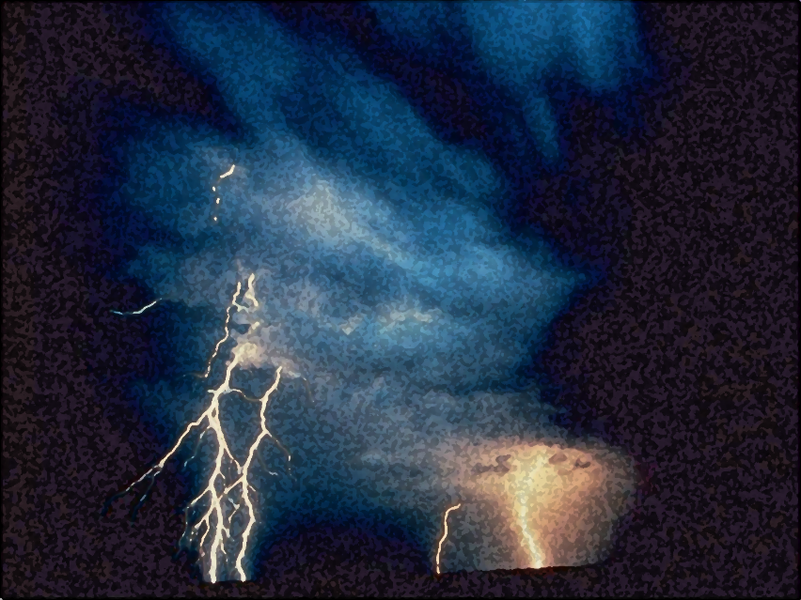
A Light out of Darkness
The Vision of Isaiah
Doom to Bloom

Slide 2
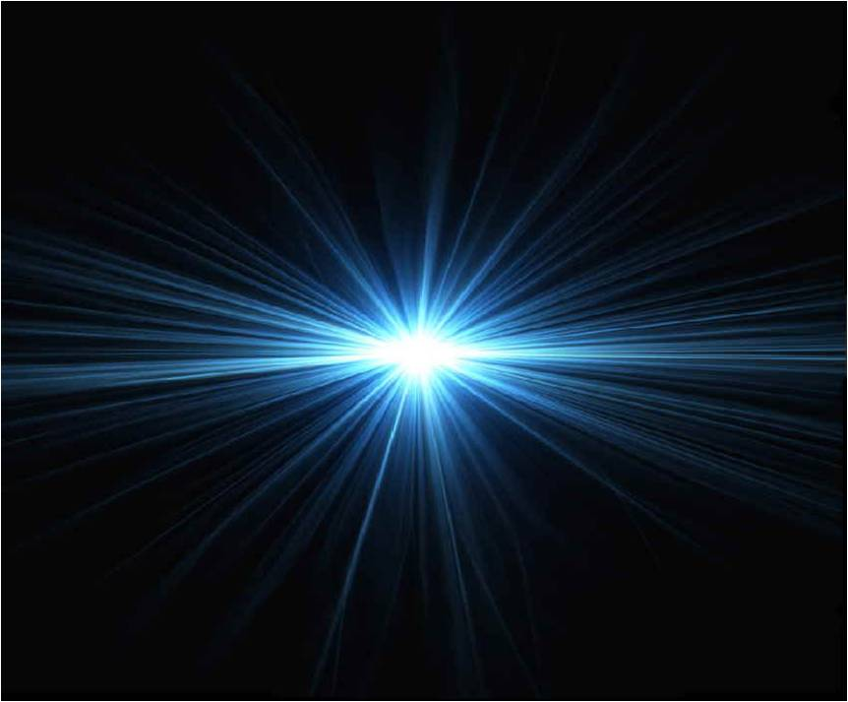
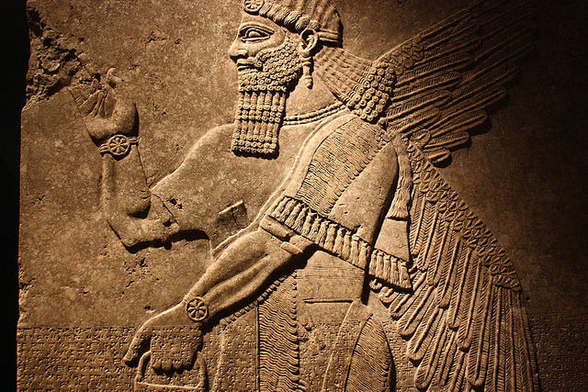
The Vision of Isaiah
God or Assyria?
An Example of Distrust
7-12
Notes:
In whom will Ahaz trust? The LORD of the universe of the lord of Assyria. In whom will we trust? God or Man. Will you choose light or darkness?

Slide 3
Will You Believe?
Signs of God’s Presence
7:1 – 9:7
“Shear-jashub”
“Maher-shalal-hash-baz”
“Immanuel”
Notes:
Signs of Gods’ are seen in the names of Children God gives to His people. The signs are seen as both the presence of God in judgment and salvation.
“Shear-jashub” – “a remnant shall return” – only shall group of people will remain after God’s judgment on His people, the good news, the salvation is, that the nation will be saved, the line of David will survive, the nation escapes annihilation.
“Maher-shalal-hash-baz” – “quick to the spoil” – God’s judgment on His people will be destructive and devastating, very little will be left standing, the good news is that God’s judgment will be swift and decisive. If it was long and prolong nothing would left. “And unless those days were shortened, no flesh would be saved; but for the elect's sake those days will be shortened.” (Matt. 24:22)
“Immanuel” – “God with us” –for us, could be a wonderful experience or a terrifying experience. It was a terrifying experience when God appeared in the presence of Assyria (later Rome) to ravage the nation. It will be a wonderful experience when God appears in a humble child that will be born, the Son that will be given from the line of David, to rule over His people with wisdom and power, bringing everlasting peace with righteousness and justice for all.

Slide 4
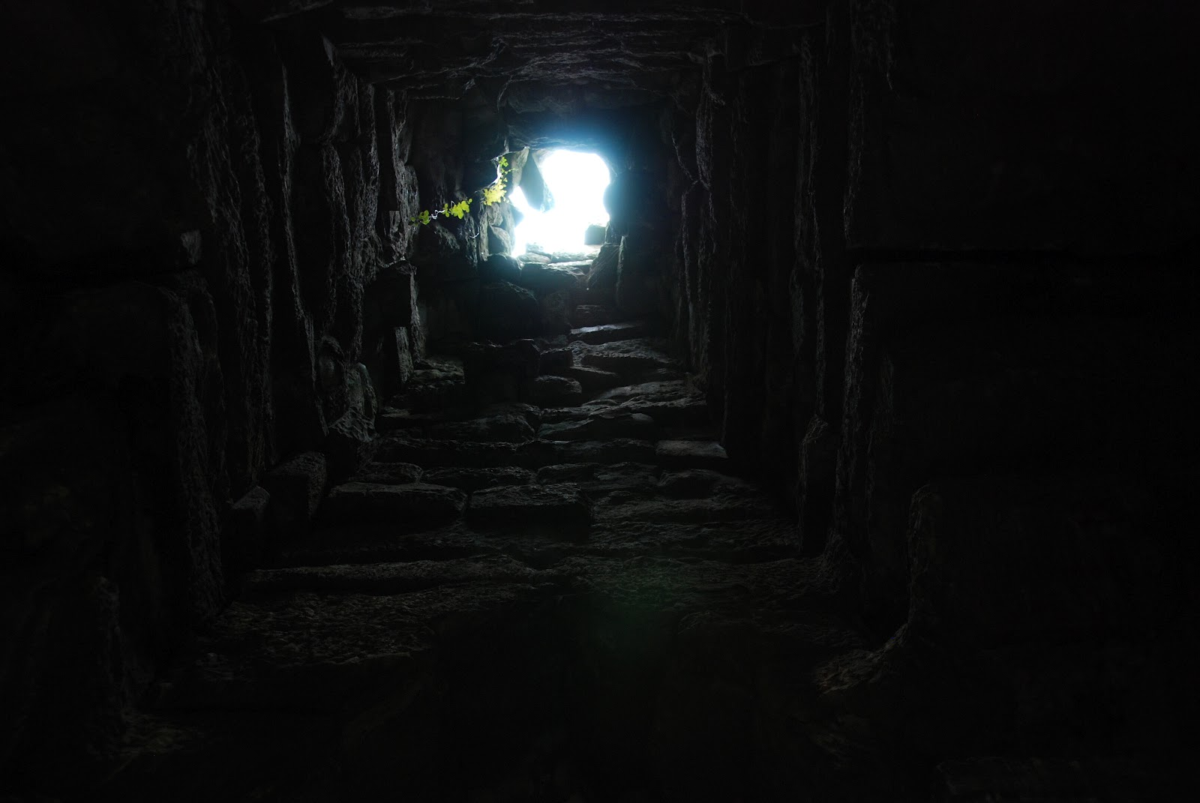
Will You Believe?
Our Way – Darkness;
His Way – Light
8:11-23
Notes:
The question remains which side of God’s presence do you prefer? The dark side or the light side. This section reflects on what preceded it and prepare the way for the announcement of the description of the child and the character of His Kingdom.
“It makes plain the central theme of the segment: “In what, or in whom, shall we trust?” One possibility when faced with potential calamities or disasters, is to forget God’s sovereignty and proceed accordingly, but to do so is to invite the calamity of more profound nature, for God is the one fact we dare not overlook. It is sheer foolishness (our way), when he has made his way clear to resort to some other means to find a path out of darkness. These other means that man devises can only make the darkness, and our anguish, more intense, for they lead away from him who is the Light. Nevertheless, God will not be defeated. He will shed his light upon his people.

Slide 5
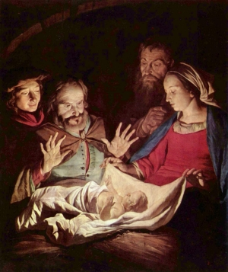
Will You Believe?
Unto Us a Child is Born
9:1-7
Notes:
Just as God’s judgment comes swiftly salvation can come just as swiftly. Out of darkness and doom comes a great light. The doom will turn to bloom will the Lord appears to saves His people. Joy will sweep over the people and the joy of great abundance will replace the scraps that was left after their spoil was taken from them. All the elemental fears of people is turned to joy and relief. The real source of joy is the LORD, It is in Him they rejoice.
The yoke of oppression both spiritual and political oppression will be no more. The Prince of Peace will eradicate oppression and death by bring warfare to an end.
The child to be born, this Son of David will be given the capacity to rule rightly. He will be both human and divine, wise and mighty, everlasting and extensive, righteous and just. The Lord will accomplish this with determination and enthusiasm.

Slide 6
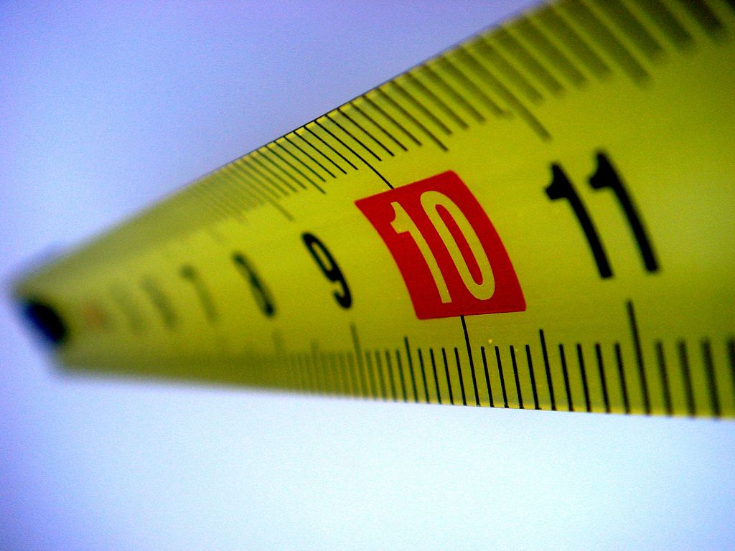
Will You Believe?
Measured by
God’s Standard
9:8 – 10:4
Notes:
This segment goes back to a previous section to answer the question, What will come of Ephraim’s plans against Judah to invade and dethrone King Ahaz, thus ending the Davidic Covenant.? Will Ahaz’s alliance with Assyria with their superior might save him and Judah?
“Isaiah’s answer is NO. It is not with Assyria with whom Ephraim and later Judah come to terms; it is God. The world is judged by God’s standards, standards which do not depend upon relative might but rather upon moral rectitude. If Ephraim goes under, it will not be because she was too weak militarily. It will be because she was measure according to the Sovereign’s moral standards and found lacking. It is not Assyria anger which Ephraim and Judah face but God’s”. (Oswalt, p. 250)
Assyria is seen as an instrument in the hands of God, herself accountable to the same standards as everyone else. The God who delivered His people into Assyria’s hand can also deliver them from that hand. In fact, He will do so, by the power of that messianic figure just described in the previous verses (9:1-7)
These verse are carefully structure as a poem. There are four strophes consisting of four lines each ending with the same refrain at the end of each strophe. A “strophe” - a structural division of a poem, containing stanzas and a chorus – 9:12, 17, 21; 10:4.

Slide 7
Measured by God’s Standard
Offenses Against God
Pride
False Leadership
Devouring One’s Brother
Oppression of the Poor
Notes:
The content moves from pride, to false leadership, to the loss of brother love to social injustice – the oppression of the poor and helpless. All of these are the great themes of Isaiah’s book which were previously mentioned in chs. 2, 3, 5, which will be mentioned in chs. 13, 14, 28-31.
The root cause of the human problem is arrogance, which then leads to the other problems, the end which is oppression.
The prophet reminds his hearers of the human behavior for which we stand condemned at the bar of God and as a result of which all nations go down to destruction.

Slide 8
Measured by God’s Standard
Ephraim’s Pride
9:8-12
Notes:
The sin for Isaiah, the source of all other sin, is the pride which exalts humanity above God, which makes God but a tool for the achievement of our plans and dreams. It is this sin and what follows for which Ephraim will be called to account.
The inhabitants of Ephraim express their pride and self-confidence, but their self-confidence is misplaced, for they are about to run head long into the God they have ignored as her muster their enemies against them.

Slide 9
Measured by God’s Standard
“The LORD sent a word against Jacob, and it has fallen on Israel.” (9:8)
Notes:
The word is sent out against “Jacob”, another name for Israel, the twelve tribes of Jacob. When God has makes a pronouncement, in a real sense that event has come to pass, an event that will “fall” upon Israel.

Slide 10
Measured by God’s Standard
“All the people will know -- Ephraim and the inhabitant of Samaria -- Who say in pride and arrogance of heart: The bricks have fallen down, but we will rebuild with hewn stones; The sycamores are cut down, but we will replace them with cedars.” (9:9-10)
Notes:
Due to archeological investigation Samaria had built a city of great elegance and luxury in a short span of time. Humanly speaking, their pride had some merit. But to leave God out of the picture is to invite disaster.

Slide 11
Measured by God’s Standard
“…though you have built houses of hewn stone, yet you shall not dwell in them; You have planted pleasant vineyards, but you shall not drink wine from them.” (5:11)
Notes:
Amos told them that…

Slide 12
Measured by God’s Standard
“All the people will know -- Ephraim and the inhabitant of Samaria -- Who say in pride and arrogance of heart: The bricks have fallen down, but we will rebuild with hewn stones; The sycamores are cut down, but we will replace them with cedars.” (9:9-10)
Notes:
They refuse to admit their limitations. Knock down a mud wall, we will rebuild it with finely dressed stones. If an invading army cut down their sycamore trees they will replace them with more valuable cedars in their place. They could be residence and resourceful, turning disaster into accomplishment. But now the LORD is about to appear.

Slide 13
Measured by God’s Standard
“Therefore the LORD shall set up the adversaries of Rezin against him, and spur his enemies on, the Syrians before and the Philistines behind; And they shall devour Israel with an open mouth.” (9:11-12a)
Notes:
The announcement of judgement is introduced by the statement of God’s intervention, “But the LORD…” It is “But the LORD…” that it is written over against all human arrogance and pomp.
The enemies of Rezin, Ephraim's king, that will arise, not in spite of the LORD, but at His bidding. From the west (Syria) and from the east (Philistine) before them and behind them, they will come to devour a people with over confidence.

Slide 14
Measured by God’s Standard
“For all this His anger is not turned away, but His hand is stretched out still.” (9:12b)
“And even then the Lord's anger against you will not be satisfied-his fist will still be poised to smash you. [TLB]
Notes:
Having removed themselves from the hand stretched out to bless them, they discovered that the hand is still outstretched, but ready to smash them.

Slide 15
Measured by God’s Standard
“Therefore the anger of the LORD is aroused against His people; He has stretched out His hand against them and stricken them, and the hills trembled. Their carcasses were as refuse in the midst of the streets for all this His anger is not turned away, but His hand is stretched out still.” (5:2)
Notes:
.

Slide 16
Measured by God’s Standard
The LORD is outraged with His people for the crimes stated here, mainly pride or arrogance, misguided leadership, social injustice and oppression. He has stretched out his hand in punishment – earthquakes in the days of Uzziah. Even still, additional punishment is coming.
Notes:
.

Slide 17
Measured by God’s Standard
“The cup of punishment is not filled by these, but the divine judgment shall still be poured out further upon the nation. The anger of God shall not be fully expressed by these minor inflictions of his wrath, but his hand shall continue to be stretched out until the whole nation shall be overwhelmed and ruined;” (Barnes' Notes, Electronic Database. Copyright (c) 1997 by Biblesoft)
Notes:
.

Slide 18
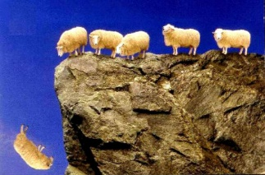
Measured by God’s Standard
Leaders who Mislead
9:13-17
Notes:
Pride and arrogance which exalts humanity results in the exaltation of the “great” men of society. This exaltation renders them less and less able to lead people.
Leadership can only come from people who know their own weaknesses and corruptibility. But to those persons who believes humanity is ultimate and accepts the glowing things people say about them, the only goal becomes to keep them saying those things. Leaders pander more and more to the what people want, the more they get the more they want, and it goes on and on. Keep giving people what they want and keep getting reelected. Sounds like an ever expanding government? The standards by which people live are only the most popular ones. The result is a progressive contamination of all goals and values by the rot of self-service and self-exaltation.

Slide 19
Measured by God’s Standard
“For the people do not turn to Him who strikes them, nor do they seek the LORD of hosts.” (9:13)
Notes:
A people who do not respond to the initial judgment of the LORD and do not turn or repent, and seek a cure from Him will find will find their foolish leaders leading them into situation where they will have no leaders at all.

Slide 20
Measured by God’s Standard
“But the rest of mankind, who were not killed by these plagues, did not repent of the works of their hands, that they should not worship demons, and idols of gold, silver, brass, stone, and wood, which can neither see nor hear nor walk. And they did not repent of their murders or their sorceries or their sexual immorality or their thefts.” (Rev. 9:20-21)
Notes:
.

Slide 21
Measured by God’s Standard
“And men were scorched with great heat, and they blasphemed the name of God who has power over these plagues; and they did not repent and give Him glory...
“They blasphemed the God of heaven because of their pains and their sores, and did not repent of their deeds” (Rev. 16:9, 11)
Notes:
.

Slide 22
Measured by God’s Standard
“Therefore the LORD will cut off head and tail from Israel, palm branch and bulrush in one day.” (9:14)
Notes:
There is coming a total destruction of leadership from the most honored to the most humble.
“in one day” – Abruptly, suddenly, judgment will come without time to prepare. The only preparation is to live as if today was the day (Mt. 24:36-44; 1 Thess. 5:4)

Slide 23
Measured by God’s Standard
“Watch therefore, for you do not know what hour your Lord is coming.” (Matt. 24:42)
But you, brethren, are not in darkness, so that this Day should overtake you as a thief.” (1 Th. 5:4)
Notes:
The only preparation is to live as if today was the day (Mt. 24:36-44; 1 Thess. 5:4)

Slide 24
Measured by God’s Standard
“The elder and honorable, he is the head; The prophet who teaches lies, he is the tail. For the leaders of this people cause them to err, and those who are led by them are destroyed.” (9:15-16)
Notes:
“Because of the self-serving attitude on the part of the leaders of the nation the people can receive no truly objective guidance. The leadership says and does only what is most likely to maintain itself in power. The result is since the guides are off the path the guided are off the path as well.” (Oswalt, p. 255) On the wide road of that leads to destruction.

Slide 25
Measured by God’s Standard
“Therefore the Lord will have no joy in their young men, nor have mercy on their fatherless and widows; For everyone is a hypocrite and an evildoer, and every mouth speaks folly.” (9:17a)
Notes:
As a result of the complete corruption of the foolish leadership God’s aid is denied to both the strong and the weak. Once the strong are destroyed in battle the weak are left defenseless at home.
To speak or act foolishly represents a conscience denial of reality, where good is evil and evil is good.

Slide 26
Measured by God’s Standard
“For all this His anger is not turned away, but His hand is stretched out still.” (9:17b)
Notes:
Their attitude is a far cry from returning to the LORD and His values, there for His hand of judgment is still upon them.

Slide 27
Measured by God’s Standard
Loss of Brotherhood
9:18-21

Slide 28
Measured by God’s Standard
“For wickedness burns as the fire;
It shall devour the briers and thorns, and kindle in the thickets of the forest; They shall mount up like rising smoke.” (9:18)
Notes:
When the leadership is destroyed and no longer exist anarchy is the result.
Two fires are describe here – One is the consuming fire of sin, which possesses the seeds of own destruction within it. “For the wages of sin is death” (Romans 3:23) Second is the God’s wrath. “It is a fearful thing to fall into the hands of an anger God”. (Hebrews )
Sins fuels the flames of greater lawlessness and devours others in its path.

Slide 29
Measured by God’s Standard
“Through the wrath of the LORD of hosts the land is burned up, and the people shall be as fuel for the fire; No man shall spare his brother. (9:19)
Notes:
The true nature of sin is not that it is a little misguided playfulness, but a rebellion against God’s order for life. As such it can only be destructive, like a grass fire that proceeds into the tress of the forest and destroys it.
Sinful acts never are fully satisfied, but they still continue to seek ever increasing gratification. Only a raging fire is all that is left. The sin which scorched the land has pitted brother against brother.

Slide 30
Measured by God’s Standard
“And he shall snatch on the right hand and be hungry; He shall devour on the left hand and not be satisfied; Every man shall eat the flesh of his own arm. Manasseh shall devour Ephraim, and Ephraim Manasseh; Together they shall be against Judah.” (9:20-21a)
Notes:
The devouring nature of sin destroys human relations. Brother against brother is the result.

Slide 31
Measured by God’s Standard
“For all this His anger is not turned away, but His hand is stretched out still.” (9:21b)
Notes:
.

Slide 32
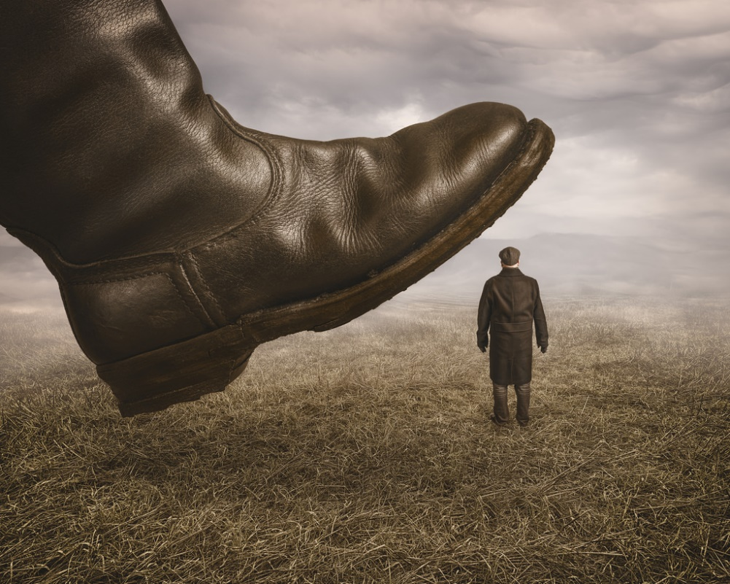
Measured by God’s Standard
Oppression of the helpless
10:1-4
Notes:
The full manifestation of human pride is oppression. When persons consciously deprive the helpless of their rights in order to oppress them, at this point the lowest limits of cynicism and self-serving have been reached. This is when the idea that all men/women and races are created equal is throw out the window. Not every is as equal as others.

Slide 33
Measured by God’s Standard
“Woe to those who decree unrighteous decrees, who write misfortune, which they have prescribed to rob the needy of justice, and to take what is right from the poor of My people, that widows may be their prey, and that they may rob the fatherless.” (10:1-2)
Notes:
Those who pass laws only are doing so in such away as to enrich themselves at the expense of the helpless. [Richest county in the counties are those surrounding Washington, D.C.] Some only use the poor in order to maintain their power. They are ever promising them and end to their poverty but their promise is never keep and the poor remain poor.

Slide 34
Measured by God’s Standard
“What will you do in the day of punishment, [visitation] and in the desolation which will come from afar? To whom will you flee for help? And where will you leave your glory?” (10:3)
Notes:
The Master has only entrusted the leaders their positions and will shortly come to assets their work. What will they do then? What will you do then? For every believer will stand to give an account of their work before the Judgment seat of Christ. To act as if we were accountable only to ourselves is to fly in the face of reality.
It is not a matter of “if” but of “when” the Master comes.
“the day” is the day of “punishment” the day of “visitation” - God with Us - Us before God”. It will be a day of disaster from which no one can flee and hide, for the only refuge is the very One who brings the disaster.
The position and power they possessed to enable them to walk all over the helpless will be meaningless before God. Before the wrath of God, status, power, and wealth means nothing.

Slide 35
Measured by God’s Standard
“Without Me they shall bow down among the prisoners, and they shall fall among the slain.’
For all this His anger is not turned away, but His hand is stretched out still.” (10:4)
Notes:
The position and power they possessed to enable them to walk all over the helpless will be meaningless before God. Before the wrath of God, status, power, and wealth means nothing. The great men who have enriched themselves at the expense to the poorest and helpless will suffer the same fate as everyone else, either huddle among the captives or their dead body will lay in heaps of the slain.
Still there is more judgment to come.
Conclusion: Oswalt page 260.

Slide 36
Notes:
The position and power they possessed to enable them to walk all over the helpless will be meaningless before God. Before the wrath of God, status, power, and wealth means nothing. The great men who have enriched themselves at the expense to the poorest and helpless will suffer the same fate as everyone else, either huddle among the captives or their dead body will lay in heaps of the slain.
Still there is more judgment to come.
Conclusion: Oswalt page 260.

Slide 37
Will You Believe?
Hope Despite Destruction
Notes:
There is hope. Hope shines out of darkness. The gloom and the doom is not final. The darkness and emptiness is not an end in itself but a means whereby God’s goodness can be manifested in the salvation of the land. When every human attempt to bring light has failed, then God will bring light, not because He has to, or that man has force Him, but merely out of His own grace, it is a gift of God.

Slide 38
The Vision of Isaiah
Notes:
Trust the Lord and believe His signs/evidence that His Word is true, and you will be established on the earth. Distrust the LORD and refuse the evidence and perish from the earth.

